Slide 1

Interoperability Thomas Künneth
https://unsplash.com/photos/m0l9NBCivuk

Slide 2
Inter... what...?
Combining Jetpack Compose and traditional Views
by using Compose in XML based layouts
by using a View in a Compose hierarchy
Why would I want that? 🤔

Slide 3
Migrate to Compose step by step
Getting to know Compose takes some time, so better start small
Big bang migrations just don’t work

Slide 4
Constraints and preconditions
A required View may not be available as a composable
The app uses a View-based third-party library
Preserve investments by keeping self-developed or acquired custom components (for a while)
We need it anyway: fragments and activities rely om Views

Slide 5
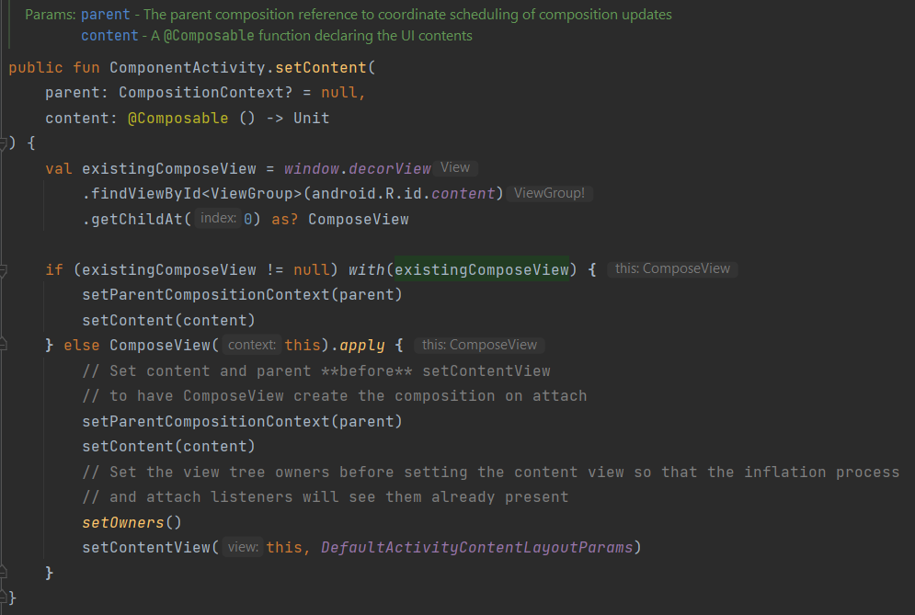
setContent { ... } is used to show a Compose hierarchy in an Activity
Uses ComposeView under the hood
setContentView() is used in almost all activities

Slide 6
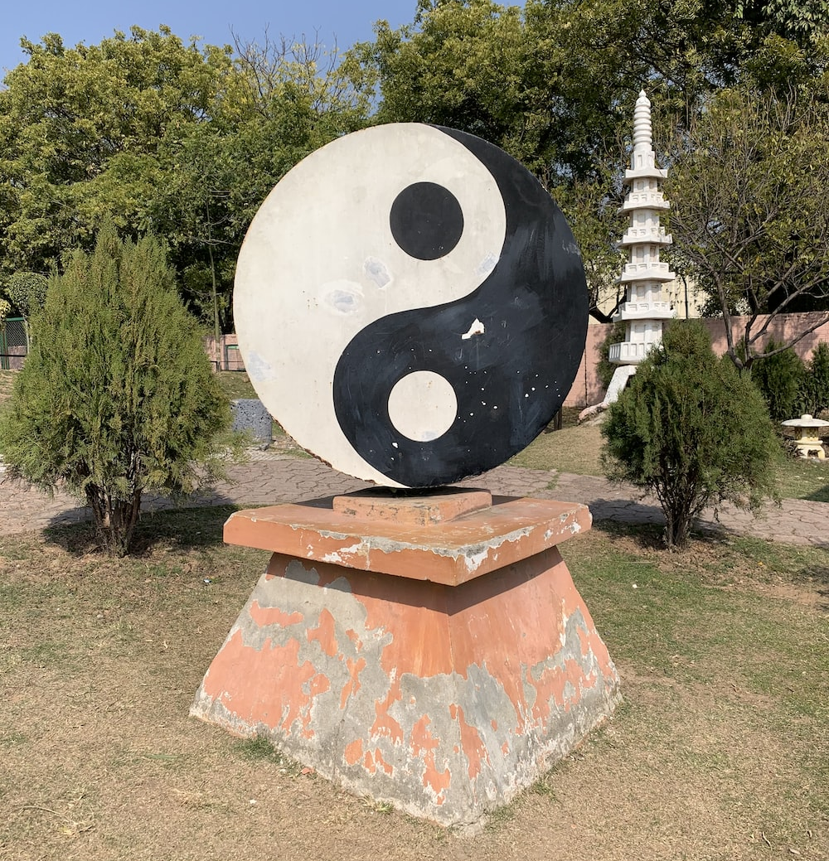
ComposeView hosts a Compose hierarchy
AndroidViewBinding() and AndroidView() host View hierarchies
https://unsplash.com/photos/vYgjtzcoEDY

Slide 7
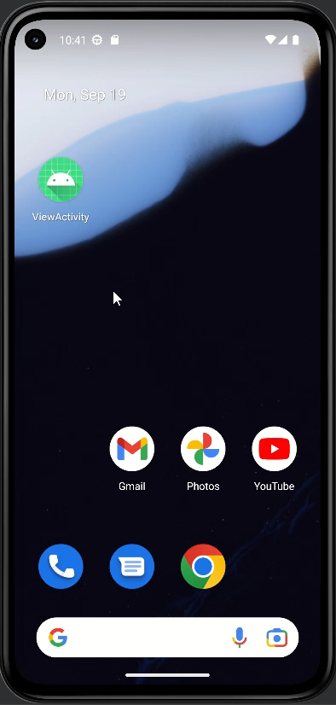
InteropDemo

Slide 8
To include a Compose hierarchy...
Use ComposeView in the layout file
Configure the ComposeView
Implement the composable

Slide 9
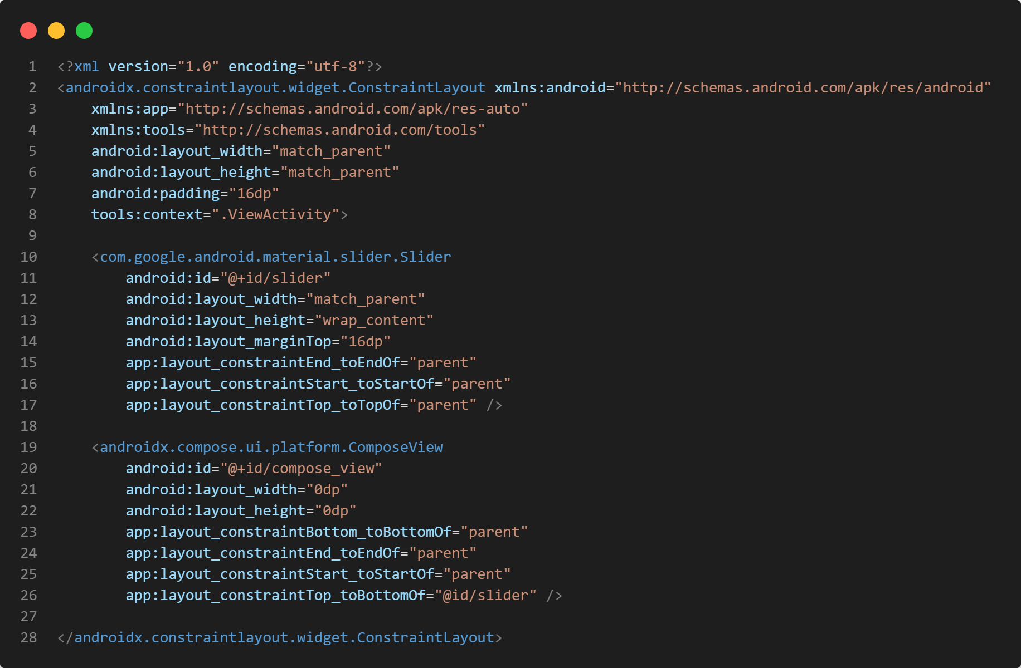
A parent layout
Some children
Render a Compose hierarchy

Slide 10
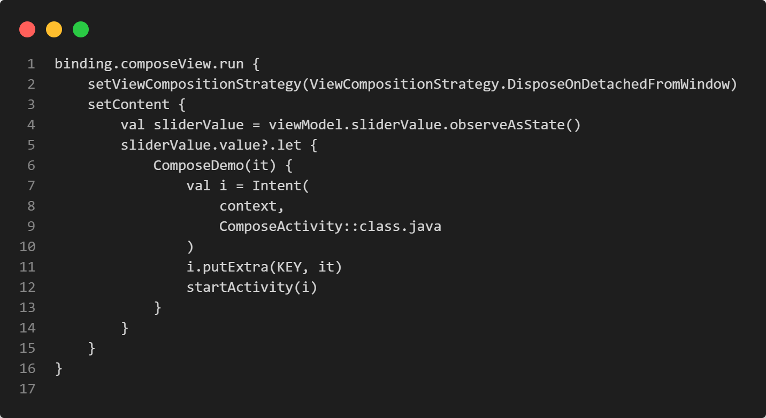
We are using View Binding
When to dispose the Compose hierarchy
We use a ViewModel ... for what...?
Invoke the root composable

Slide 11
ViewModels contain data and logic needed by Views
Have been an established pattern on Android for many years
Used on other platforms before they became mainstream on Android

Slide 12
Greatly ease synchronization of Views and composable functions
Should be used in any Android app anyway, because they
help structure and unclutter the code
help sharing data among activities and fragments
have their own independent lifecycle

Slide 13
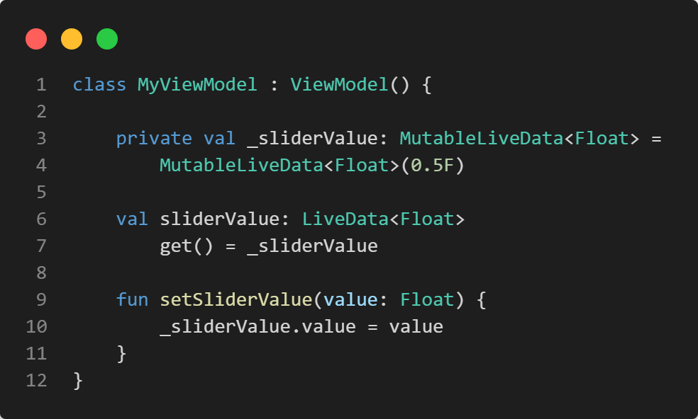
Usually extend androidx.lifecycle.ViewModel
Store (changeable) observable data
Allow observation of such data
Provide means to change data

Slide 14
Implementation of observable pattern (LiveData, Kotlin Flows, ...) can be chosen based on requirements
If an app already uses ViewModels the current implementation should be re-used to avoid changes to View-based code
The conversion to Compose state depends on the chosen implementation

Slide 15
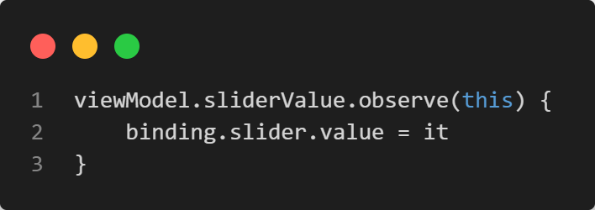
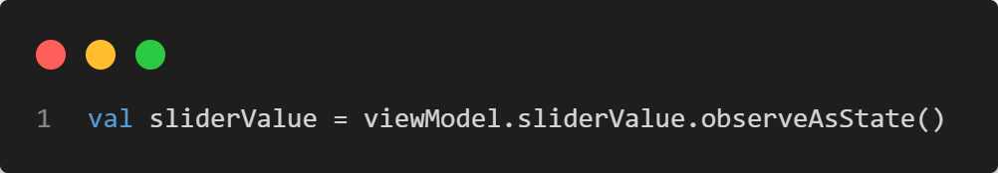
Observing a ViewModel property
for views
for composables

Slide 16
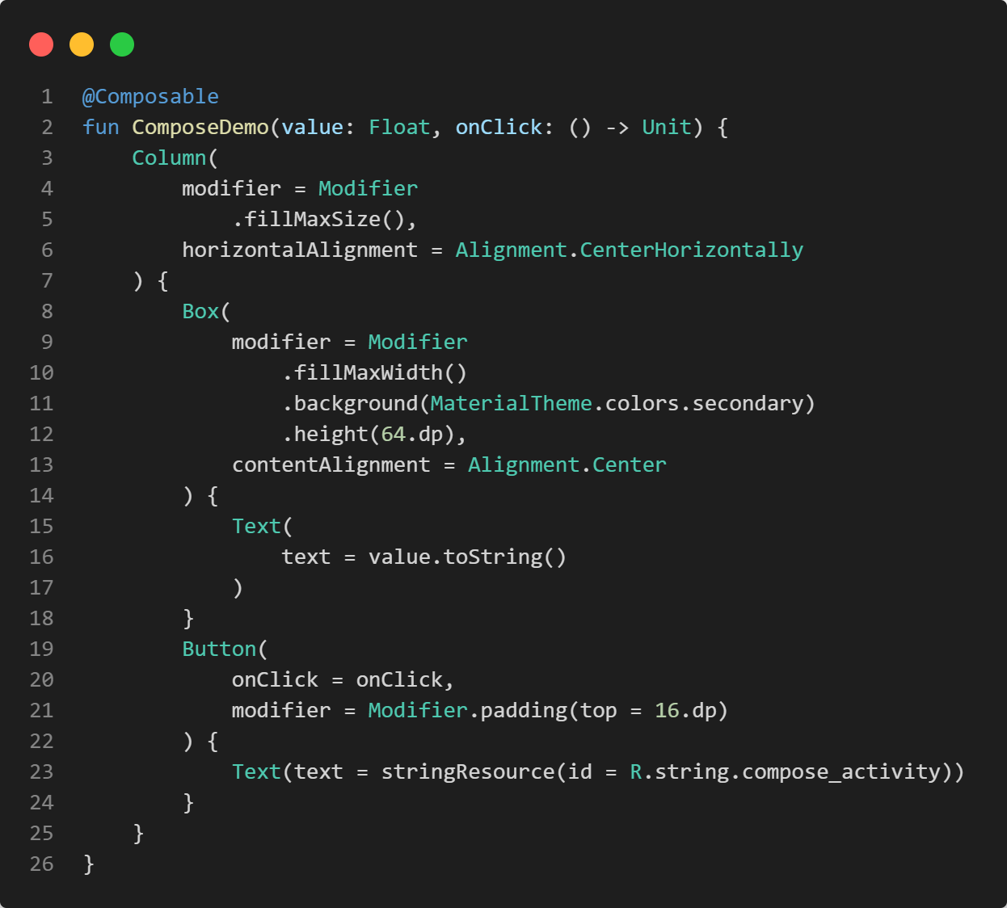

Slide 17
To include a View hierarchy...
Inflate the View hierarchy
Define the logic for changes
Embed in a Compose hierarchy

Slide 18
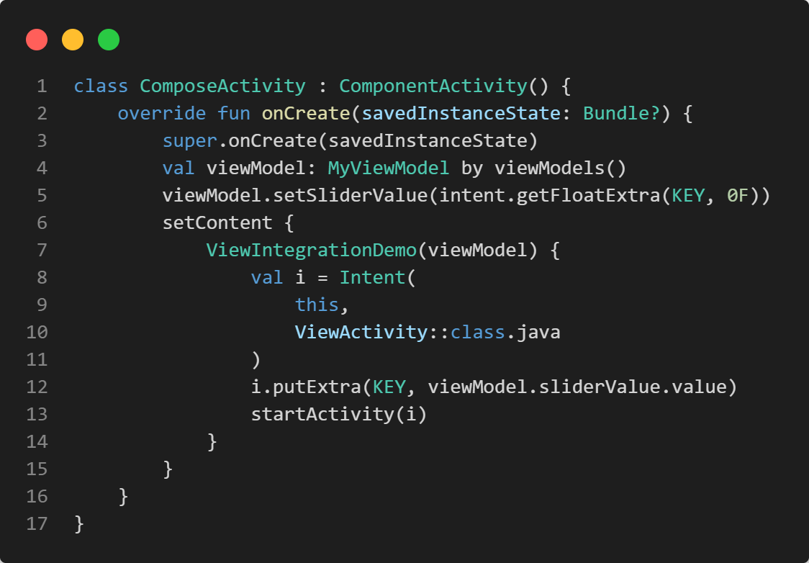

Slide 19
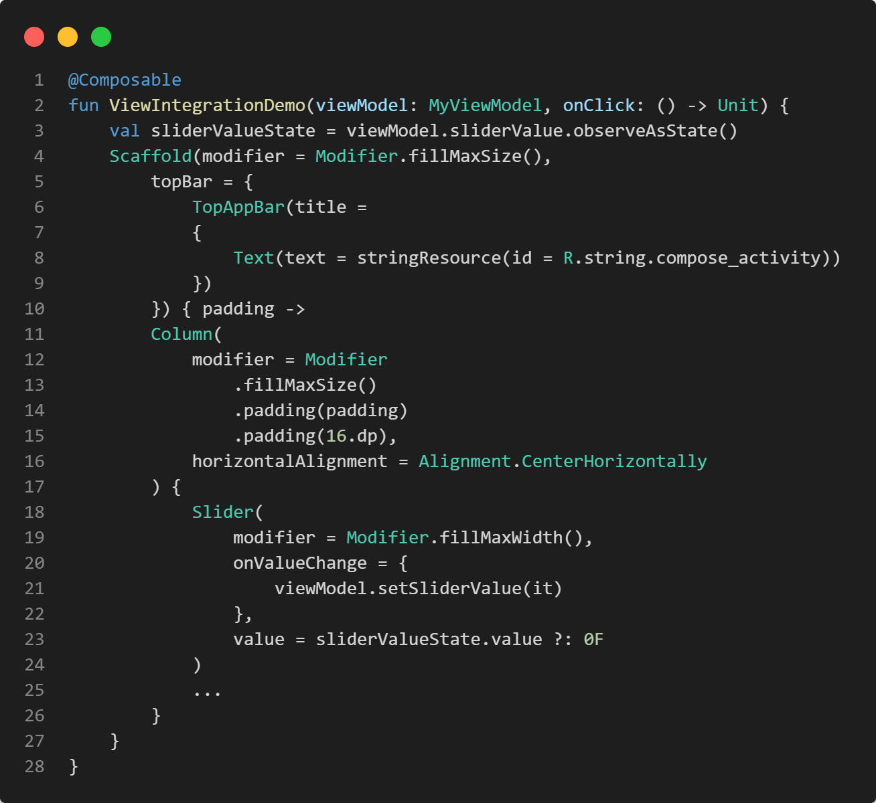

Slide 20
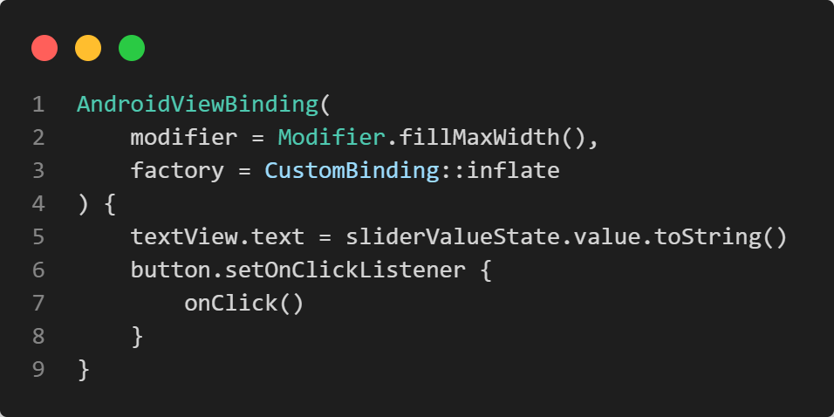

Slide 21
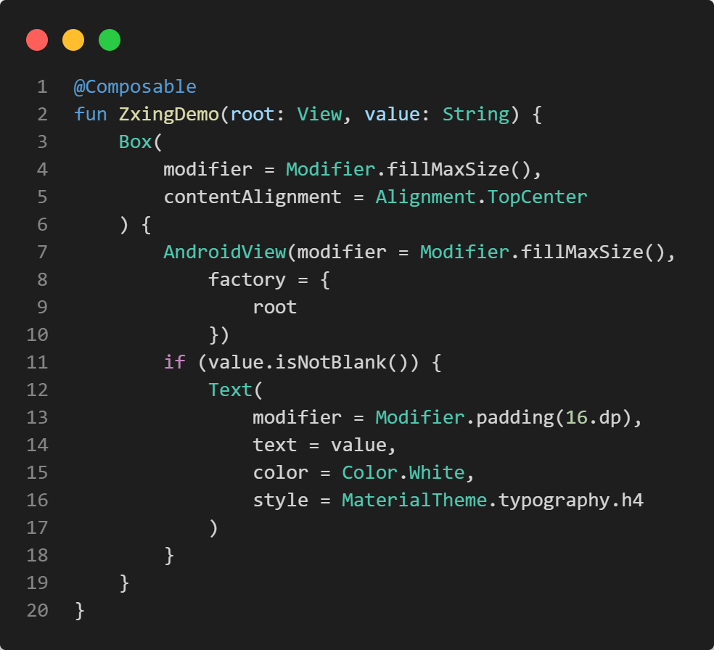
ZxingDemo

Slide 22
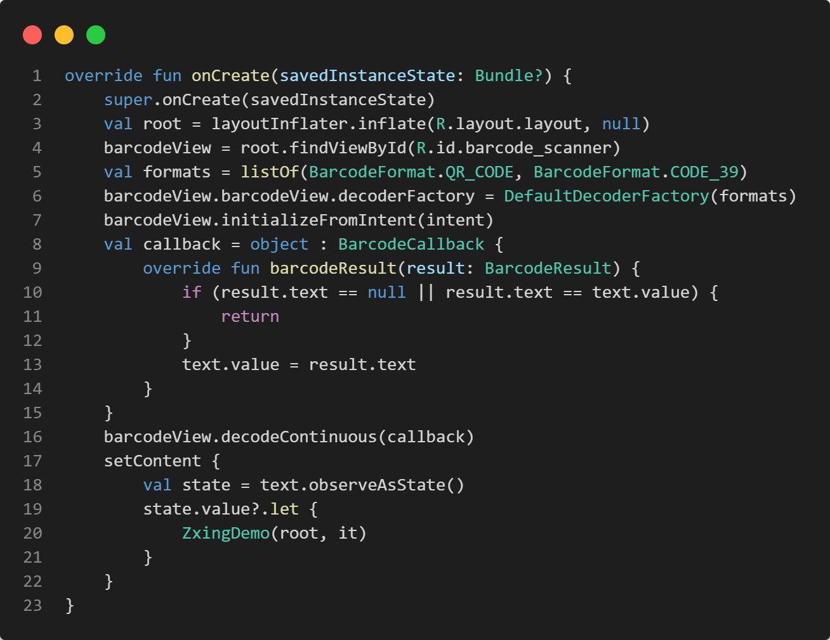

Slide 23

Exercise
https://unsplash.com/photos/IZOAOjvwhaM

Slide 24
Now try for yourself
Create an app, that either
is based on a View hierarchy and uses ComposeView
is based on a Compose hierarchy and uses AndroidView() or AndroidViewBinding()
Your app should include a simple ViewModel with a value that is read and written on both sides

Slide 25

Questions…?
Short break… 😍

